Slide 1

SMART INDIA HACKATHON 2026
Problem Statement ID – 26056
Problem Statement Title- Development of a Real-time Airfare Price Index for India through Automated Web Scraping of Airline and Online Travel Aggregator Portals for Augmentation of the Consumer Price Index (CPI).
Theme- Smart Automation
PS Category- Software
Team ID-
Team Name – Woven tech

Slide 2




Woven tech
APIx – Airfare Price Index
Proposed Solution
Why Problem
APIx frequently collects automated Real-
Time airfare data using Python + Playwright .
Collects data from major airlines and OTAs
(Online Travel Aggregators) websites .
Gather fares from multiple Purchase windows
ex- T+1,T+7,T+15,T+30 days to observe how
airfare changes with booking time.
Detect duplicate flights appearing on different
websites and group them together.
Use weighted median method to calculate a
representative fare for each flight/route.
Provide route specific data, price trend, show
heatmap and anomaly alerts to DGCA.
Uniqueness
Airfare is dynamic vary with
advance booking window ,
festival seasons, route basis .
CPI only provides state specific
data that is also monthly basis .
Currently airfare inflation is
calculated manually with only
10% of data .
Show real time and high
frequency data .
Route - level intelligence .
Booking window analysis .
Use DGCA traffic statistics for
route prioritization .

Slide 3

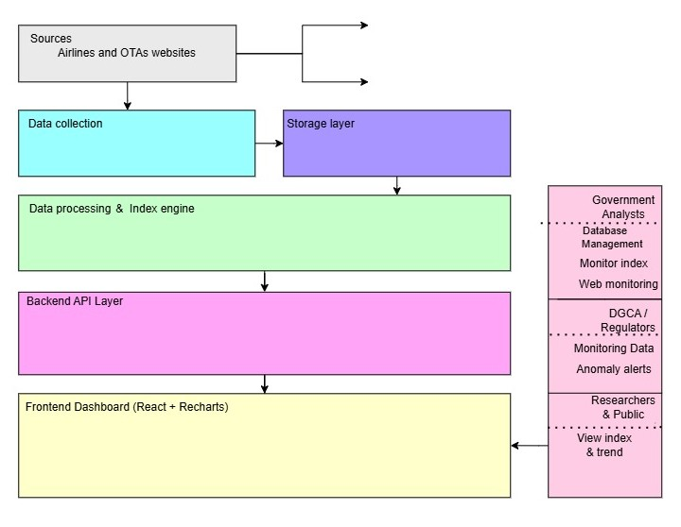


















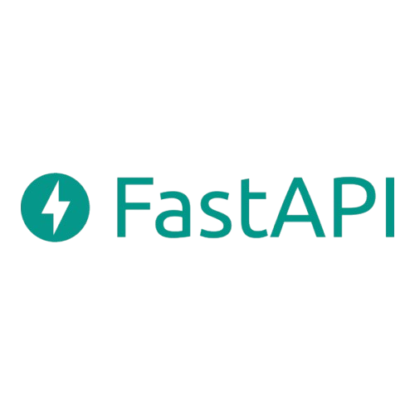






Woven tech
System Architecture
Scheduler
Python
Storage
Tech Stack
Government Analysts
Monitor Index
Route Analysis
Data cleaning
and normalization
Weighted
median
DGCA Route weighting
Price Index
DGCA/
Regulators
Index API
Route
API
Trend API
Data
API
Index API
Oversight
Monitoring
Public/
Researchers
Route Analysis
Anomaly
Alert
View Insights
& trends
Price trends

Slide 4




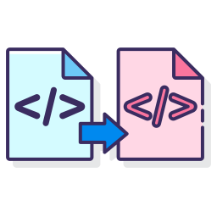



FEASIBILITY AND VIABILITY
Woven tech
Feasibility
Viability
Technical Feasibility : Uses proven technologies
ex:- Python, Playwright, PostgreSQL, Fast API .
Economic Feasibility : Low software cost
Open - source technology stack .
User Feasibility : Centralized airfare intelligence for analysts .
Reduces manual data collection .
Continuous data Better market visibility .
Start small Scale progressively .
Cost effective open-source technology used
Risk
Mitigation
Anti-bot detection/ captcha blocks
scrapping .
Duplicate flight/ fare records
High data volume at scale
Compliant to rate limiting + permitted/ public sources
Uses deduplication pipeline .
Scalable cloud infrastructure solves it

Slide 5

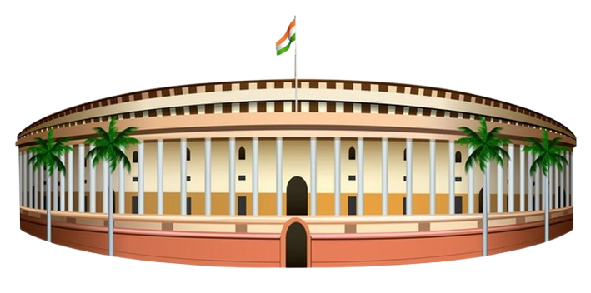


Woven tech
Impacts and benefits
Government
Impact
Economic
Impact
Social
Impact
Technological
Impact
Route wise price
intelligence .
Identify transportation
cost pressure .
Reduces manual analysis .
Helps identify high-fare periods/routes .
Understand booking - time effects .
Supports passenger –
focused policies .
Automates high-frequency airfare data collection.
Integrates multiple data sources into a unified pipeline
API-driven analytics dashboard .
Dedicated Airfare Price Index .
Data-driven regulatory
insights .
Alert DGCA/regulator
to abnormal or sudden fare increases.

Slide 6
RESEARCH AND REFERENCES
Woven tech
Primary sources :
MoSPI for CPI context - Product | Ministry of Statistics
DGCA Air Traffic Data - Home | Directorate General of Civil Aviation | Government of India
Market understanding :
Airline websites - Book Domestic and International Flights at Lowest Airfare
SpiceJet - Flight Booking for Domestic and International, Cheap Air Tickets
Air India: Book Domestic & International Non-Stop Direct Flights
OTAs websites - Flight Booking, Cheap Flights , Air Ticket Booking at Lowest Airfare | MakeMyTrip
ixigo - Best Travel Website, Book Flights, Trains, Hotels & Buses
Flight Ticket Booking, Cheap Flights, Air Tickets at Lowest Airfare | EaseMyTrip
Others :
India Service Producer Price Index Q1 FY27: Air Travel Prices Surge, Banking Declines

